Slide 1
Losses in Optical Waveguides

Slide 2
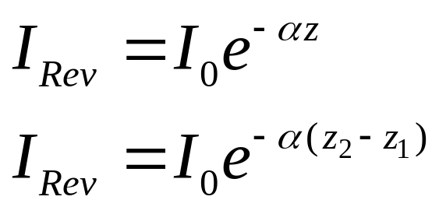
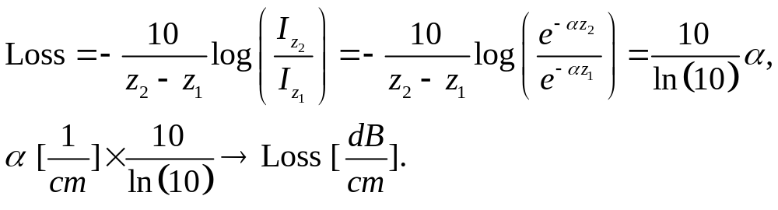
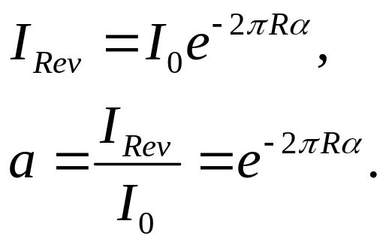
Losses in Optical Waveguides
Absorption Loss
Bending Loss
Volume scattering Loss
Surface scattering Loss

Slide 3
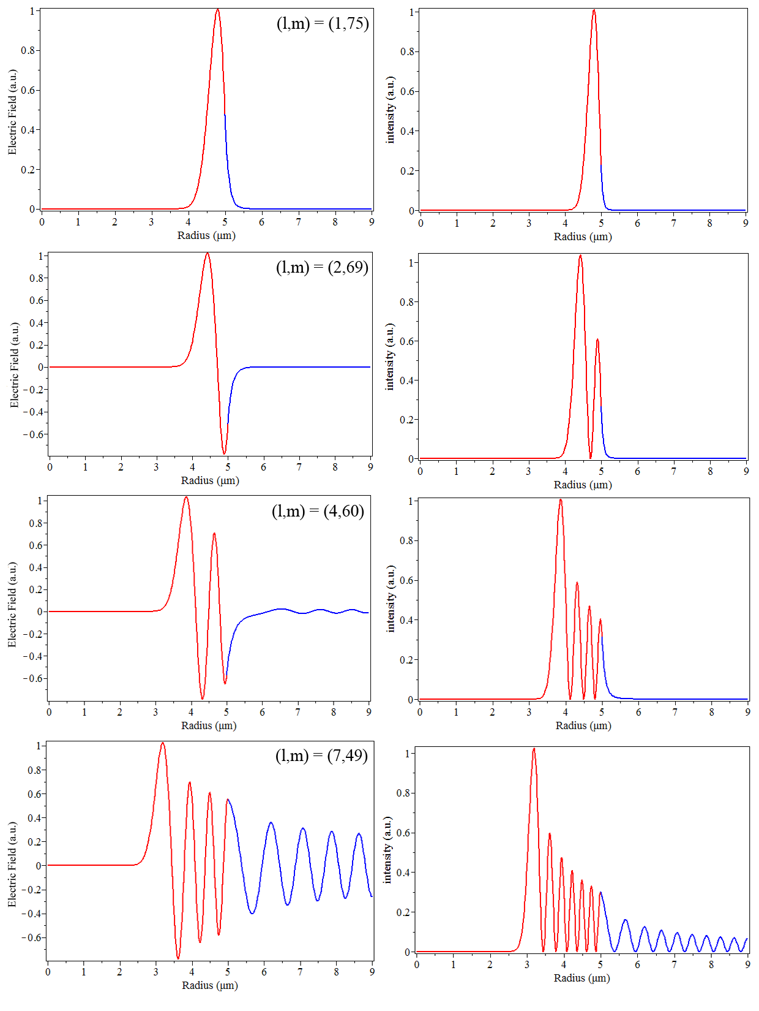
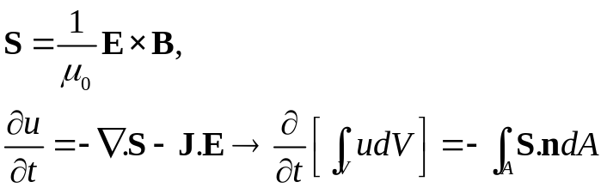
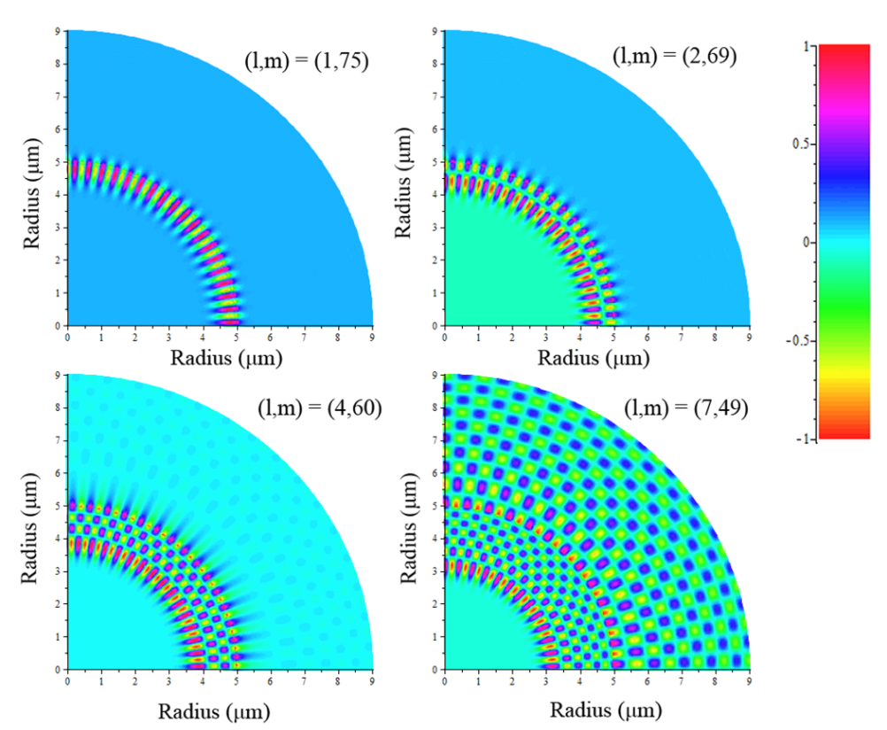
Losses in Optical Waveguides
Bending Loss

Slide 4
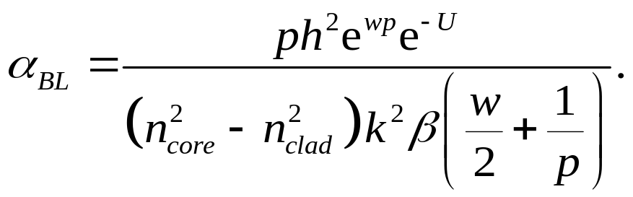
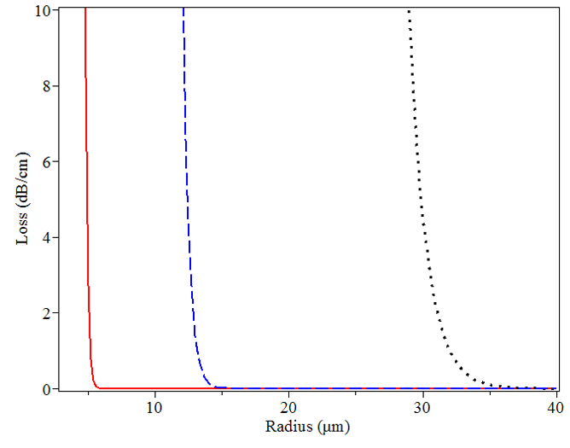
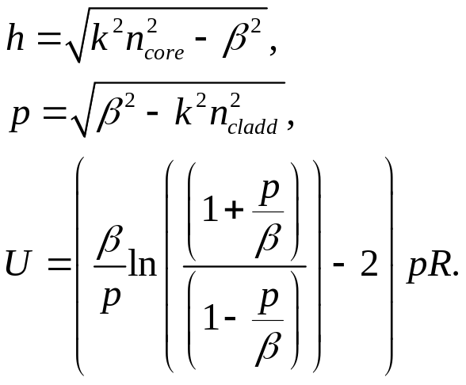
Losses in Optical Waveguides
Bending Loss
N=1.45
N=1.3
N=1.15
Nclad=1.45
D. Marcuse, “Bending Loss of Asymetric slab waveguide”, American Telephon and Telegraph Company The Bell System Technical Journal, Vol. 50, No. 8, 1971.

Slide 5
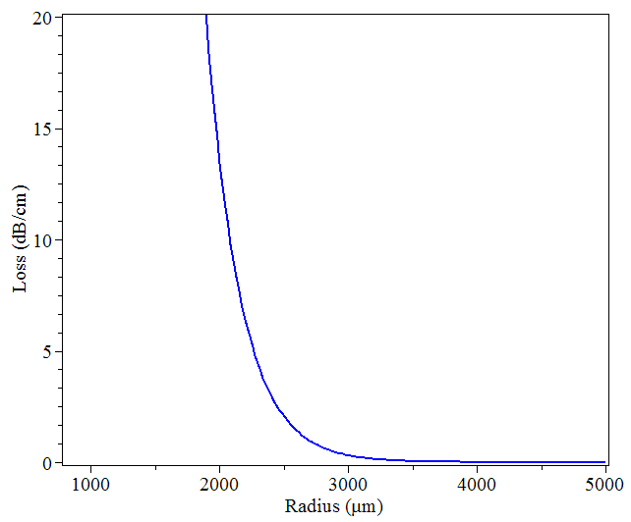
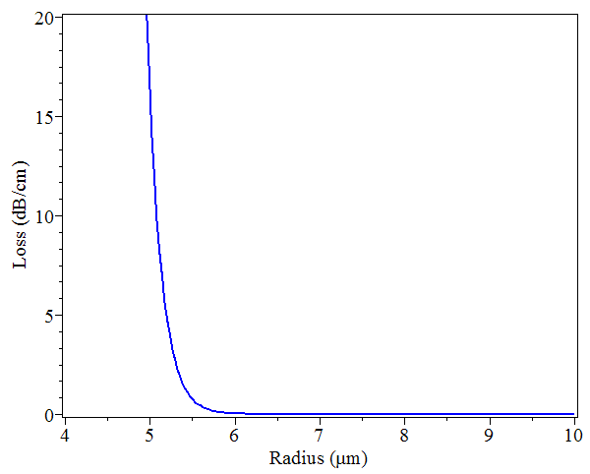
Losses in Optical Waveguides
Bending Loss
Δn=0.01
Δn=0.5
Δn=ncore - ncladd

Slide 6
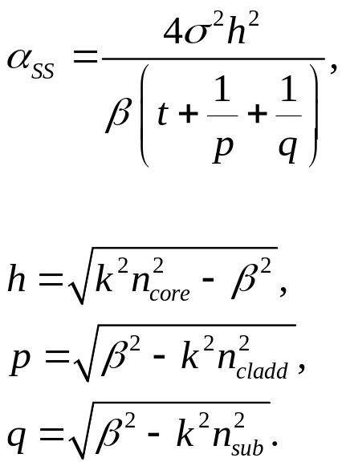
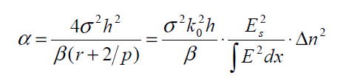
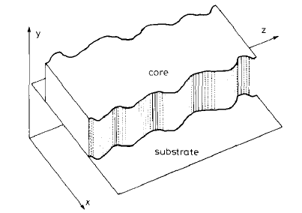
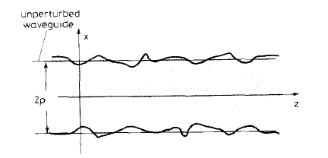
Losses in Optical Waveguides
Surface scattering Loss
Yurii A. Vlasov and Sharee J. McNab ,“Losses in single-mode silicon-on-insulator strip waveguides and bends”, OPTICS EXPRESS, Vol. 12, No. 8, 2004.

Slide 7
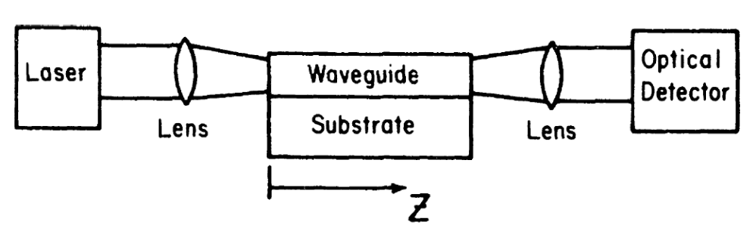
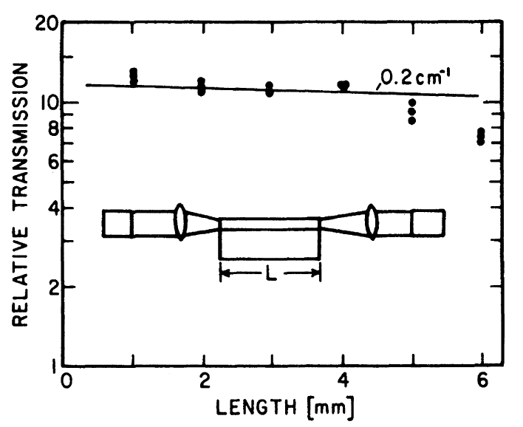
Measurement of Waveguide Losses
End Coupling to Waveguides of Different Length
Assuming that the waveguide is homogeneous.
It is generally destructive
• Advantage
– Simple and direct
• Disadvantage
– Alignment sensitive
– End face condition should be consistent
– Can’t distinguish the loss associated with different mode number

Slide 8
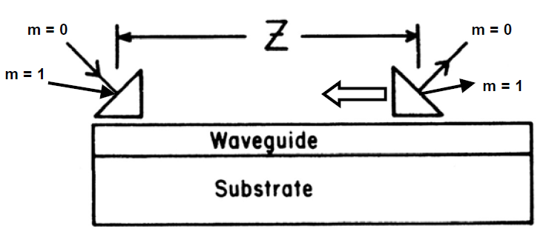
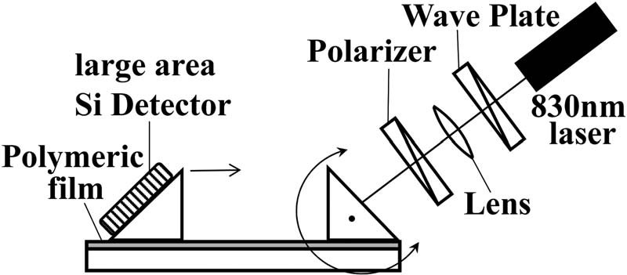
Measurement of Waveguide Losses
Advantage
– Can measure the loss from different modes
– Alignment insensitive
– End face quality is not required
Disadvantage
– Less accurate
Assuming that mode conversion is insignificant →
The loss for each mode can be measured separately

Slide 9
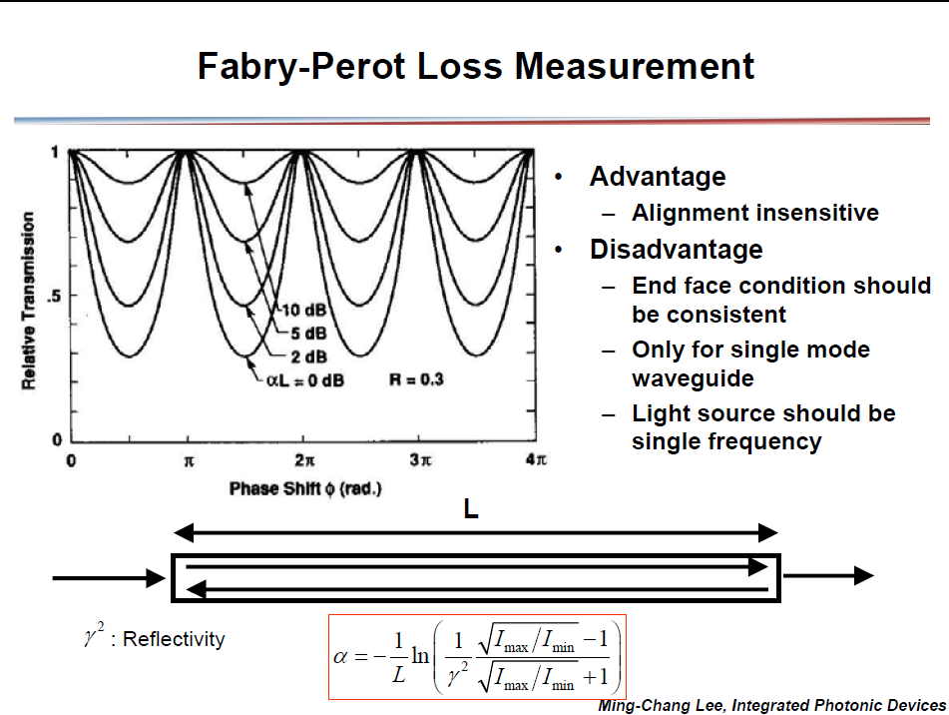
Measurement of Waveguide Losses

Slide 10
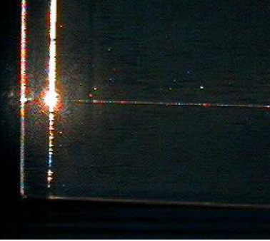
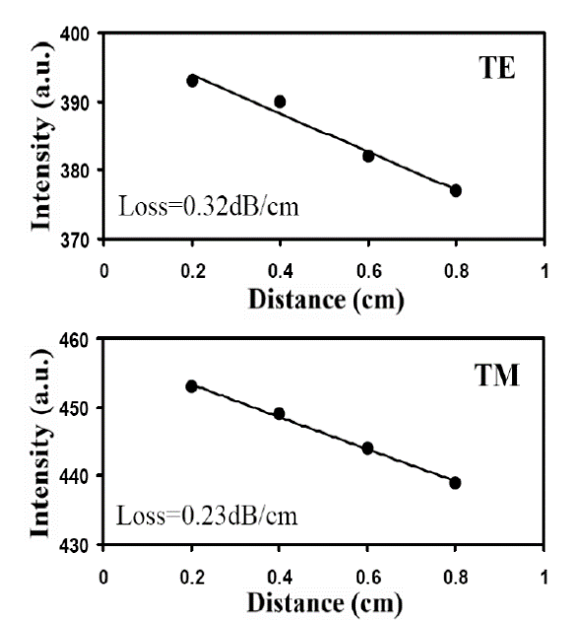
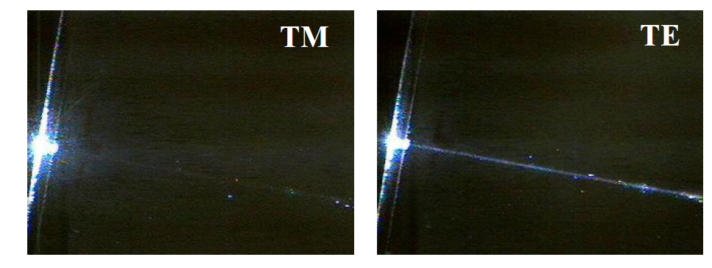
Measurement of Waveguide Losses
Scattering Loss Measurements

Slide 11
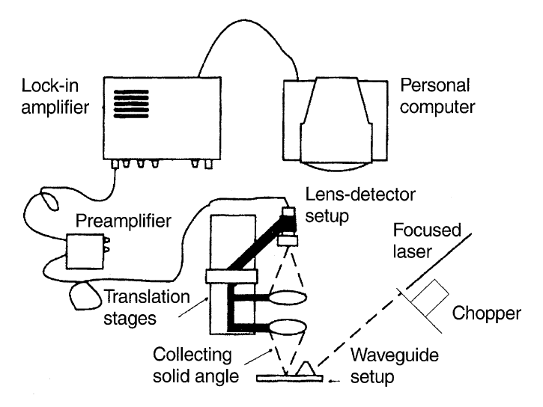
Measurement of Waveguide Losses
Scattering Loss Measurements

Slide 12
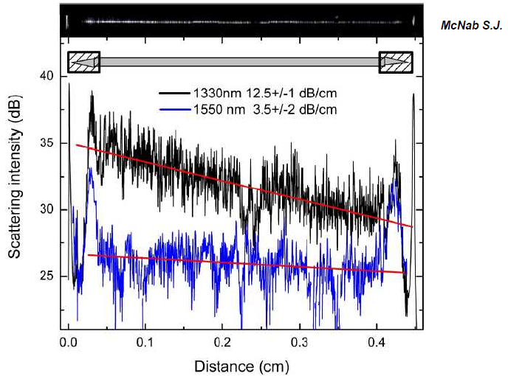
Measurement of Waveguide Losses
Scattering Loss Measurements

